Slide 1

Big Mountain Ski Resort Revenue Analysis
Bryan Spencer
Springboard – Data Scientist

Slide 2
Current Situation
New chair lift
Maintain profit margin
Recently installed a chair lift
Increases operating costs by $1.54M
Management and investors want to maintain 9.2% profit margin this winter season
Assumptions :
350,000 visitors with 5 ticket purchases
Current ticket price $81
How can Big Mountain Resort maintain a 9.2% profit margin this winter season while accounting for an additional $1.54M increase in operating cost due to the purchase of an additional chair lift?

Slide 3
Problem Statement
How can Big Mountain Resort maintain a 9.2% profit margin this winter season while accounting for an additional $1.54M increase in operating cost due to the purchase of an additional chair lift?

Slide 4
Recommendations
Immediate :
Short Term :
Increase ticket price to model suggested minimum $85.48, adding $7.8M revenue for the season
Eliminate or close an existing run with no effect on revenue. Target runs with high maintenance costs to improve profitability
Adjust final ticket price within model set ticket price range ($85.48 - $106.26) accounting for market response.
Add a run to increase the vertical drop by 150 feet and install an additional chair lift to increase ticket price by $1.99, an overall increase of nearly $3.5M in revenue.

Slide 5
What data are we using to help model price?
Dataset
Resort Statistics
CSV file sent by data base manager
Includes ski resort statistics from 330 resorts in the US
Initial analysis to predict ticket price based on resort statistics
Mountain details (elevation, vertical drop)
Chair lifts (types, speed)
Runs, terrain parks, snow making area
Operating details (days open, years of operation, snowfall, price)

Slide 6
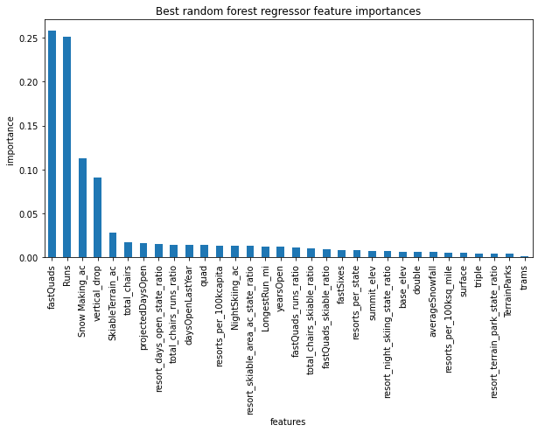
Model - Analysis
Model Details
Random Forest Regressor trained on entire data set to predict Adult ticket price
Four features showed significant importance when predicting ticket price :
Fast quad chair lifts
Number of runs
Snow making area
Vertical drop

Slide 7
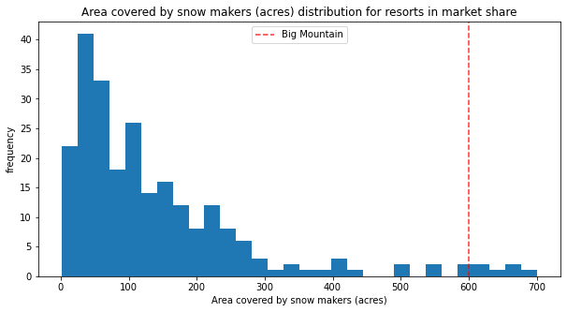
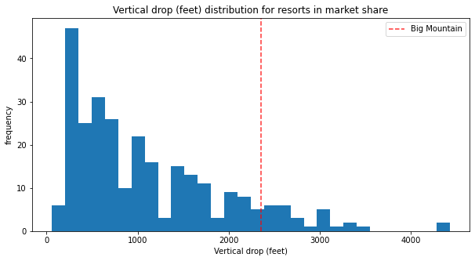
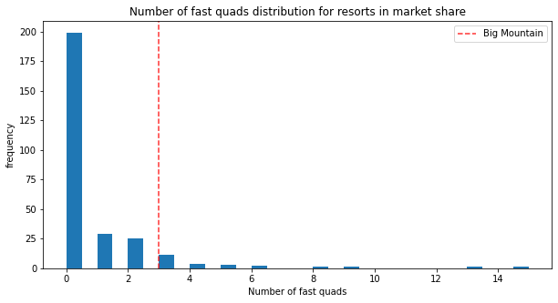
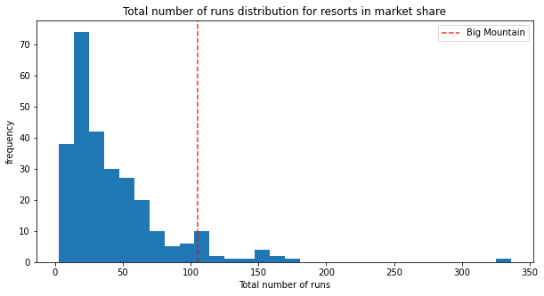
How does Big Mountain rank in important features?
Top 15%
Top 10%
Top 5%
Top 7%

Slide 8
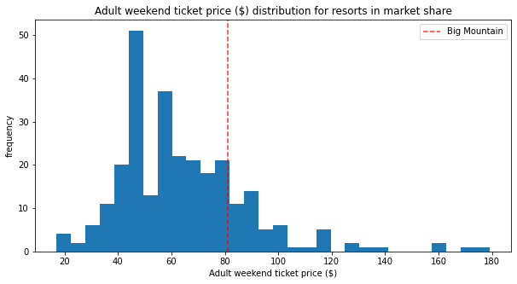
How does Big Mountain rank in price?
Pricing comparison and adjustment
Big Mountain ranks in top 15% in four of the most important statistics
Only ranks 81st percentile for price ($81)
Room for price to increase based on market context
Model suggests set price between $85.48 to $106.26 based on current resort amenities.
Correlates to overall revenue increase of $7.8M – $44.5M per season.

Slide 9
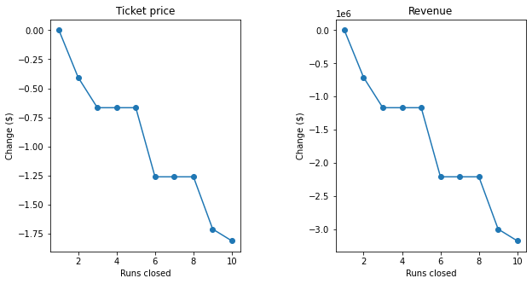
Other methods to maintain / improve profitability
Close runs to reduce operating cost
Closing 1 run has no affect on revenue.
Closing 3 – 5 runs has the same effect on revenue.
Need more information about operating costs to fully analyse cost / benefits.

Slide 10
Other methods to increase revenue
Install new chair lift, add a run that increases vertical drop by 150ft
.
Increase vertical drop by 150ft by adding a run.
Install new chair lift to accommodate new run.
Model predicts the ticket price to increase $1.99 based on new amenities.
Increase of $3.5M in seasonal revenue.
Need to account for potential costs of additional chair lift ($1.54M based on current

Slide 11

Conclusion
Model can take in extensive information on resort amenities and offer profitability of future decision making.
Can make immediate improvements in profitability with expected ticket price based on current amenities.
Initial mandate of maintaining 9.2% profit margin is achievable and can be easily exceeded based on data driven decision making.

Slide 12





Thank You
April Hansson
Bryan Spencer
(281) 660 2952
bryan.r.spencer@gmail.com
github.com/brspencer90

